Slide 1

Pediatrics 2025:
The AMSPDC Workforce Initiative
NASEM Study
Slides and Talking Points for AMSPDC Chairs
Pediatrics 2025: The AMSPDC Workforce Initiative
www.amspdc.org/workforce
@AMSPDC
#Peds2025Workforce

Slide 2
Discussion Points
  Why invest in pediatric health care and pediatric subspecialists
  Background data on the match and salary analysis
  NASEM study findings and recommendations on the pediatric subspecialty workforce
Pediatrics 2025: The AMSPDC Workforce Initiative
www.amspdc.org/workforce
@AMSPDC
#Peds2025Workforce

Slide 3
Why Invest in Pediatric Health Care?
Children are our future
  A growing number of adult diseases have their onset during childhood
  Improving care to children will decrease overall health care costs and lead to healthier adults who contribute positively to society
Children now face many risks
  High rates of poverty. Children remain the poorest subgroup in the US
  Childhood adversity leads to poor health outcomes
  Children are uniquely vulnerable to health disparities related to race and socioeconomic status
  Children’s mental health is in crisis
Children have been long-ignored by a health care system that has prioritized adults with chronic disease, often without any meaningful impact on adult outcomes
Pediatrics 2025: The AMSPDC Workforce Initiative
www.amspdc.org/workforce
@AMSPDC
#Peds2025Workforce

Slide 4
Why Invest in Pediatric Health Care?
4. Growing sophistication in diagnosis and treatment of pediatric diseases
  Genetic testing, genome sequencing
  Proteomics, transcriptomics, metabolomics
  Microbiome analysis
5. Increasing ability to provide curative therapy for pediatric disease
  Cell and gene therapy
  Bone marrow transplantation
  Other precision therapeutics
6. Increasing capacity to provide holistic care to children and families
Pediatrics 2025: The AMSPDC Workforce Initiative
www.amspdc.org/workforce
@AMSPDC
#Peds2025Workforce

Slide 5
Why Invest in Pediatric Subspecialists?
Pediatric subspecialists play critical role in delivering state-of-the-art care to children and adolescents
10- 20% of the nation’s children receive care from a pediatric specialist with more than one-third (38%) of children and adolescents having at least one chronic health condition
Pediatric subspecialists pursue research essential to advancing child and adolescent health
Care provided by non-pediatric subspecialists leads to poor health outcomes
Many patients live in areas of the country where there is little access to subspecialty care
Many subspecialties report long wait times for appointments, leading to treatment delays
Pediatrics 2025: The AMSPDC Workforce Initiative
www.amspdc.org/workforce
@AMSPDC
#Peds2025Workforce

Slide 6
Background Data
Pediatrics 2025: The AMSPDC Workforce Initiative
www.amspdc.org/workforce
@AMSPDC
#Peds2025Workforce

Slide 7
Percentage
Match Year
Pediatrics 2025: The AMSPDC Workforce Initiative
www.amspdc.org/workforce
@AMSPDC
#Peds2025Workforce
Notes:
Data is from the NRMP. Percentage is the number of MD Seniors who Match into a categorical pediatric program divided by the number of MD Seniors in the Match. Year reflects the year that training began.

Slide 8
Medical Student Applicants to Pediatrics
ERAS Data Show a Steady Decline
 | 2019 | 2020 | 2022 | 2023 | 2024
MD | 2124 | 2204 | 2095 | 2058 | 1831
IMG | 2125 | 2087 | 1940 | 1806 | 1769
DO | 652 | 645 | 774 | 787 | 739
Total | 4951 | 4936 | 4809 | 4651 | 4379
13.5%
16.8%
11.5%
Pediatrics 2025: The AMSPDC Workforce Initiative
www.amspdc.org/workforce
@AMSPDC
#Peds2025Workforce
Notes:
This data is collected on October 5th of every application year, so there is consistency to when the data is collected. It does not separate whether the applicant has listed pediatrics as their primary discipline or secondary discipline. However, the significant decrease in applicants in 2024 is concerning.

Slide 9
Pediatric subspecialty fellowships with fewer applicants than positions in 2024 cycle
Adolescent Medicine
Cardiology
Child Abuse
Critical Care Medicine
Developmental Pediatrics
Emergency Medicine
Endocrinology
Gastroenterology
Hematology/Oncology
Hospital Medicine
Infectious Diseases
Nephrology
Neonatology
Pulmonology
Rheumatology
Pediatrics 2025: The AMSPDC Workforce Initiative
www.amspdc.org/workforce
@AMSPDC
#Peds2025Workforce
Notes:
This year GI only filled 75% of positions and had 31 open slots and Heme Onc only filled 72% of positions and had over 50 open slots,, but the most since the Match data has been tracked.

Slide 10
Pediatric Subspecialties Applicants per Position in 2024
Specialty | # Applicants ERAS 2024 | Positions in NRMP 2024 | Applicants Per Position - 2024 | 2023 Applicants Per Position
Hospital Medicine | 133 | 124 | 1.07 | 1.17 | More than 1 applicant per position
Cardiology | 184 | 179 | 1.03 | 1.08
Critical Care | 211 | 224 | 0.94 | 1.09
Neonatal | 278 | 302 | 0.92 | 1.04 | Approximately 0.9 applicants per position
Emergency | 207 | 227 | 0.91 | 1.12
Adolescent Medicine | 28 | 34 | 0.82 | 0.74
Gastroenterology | 93 | 125 | 0.74 | 1.12
Hematology/Oncology | 129 | 184 | 0.70 | 0.89
Rheumatology | 32 | 52 | 0.62 | 0.72
Endocrinology | 62 | 100 | 0.62 | 0.65
Pulmonology | 51 | 86 | 0.59 | 0.72
Nephrology | 41 | 73 | 0.56 | 0.62
Child Abuse | 12 | 21 | 0.57 | 0.65
Developmental Peds | 28 | 49 | 0.57 | 0.69
Infectious Disease | 36 | 77 | 0.47 | 0.62
Less than 0.9 applicant
per position
Applicant data is based on # of applicants who prefer that specialty from the ppreliminary 2024 NRMP Data. Results are compared to the 2023 Final NRMP Data
Pediatrics 2025: The AMSPDC Workforce Initiative
www.amspdc.org/workforce
@AMSPDC
#Peds2025Workforce
Notes:
This slide compares the preliminary 2024 applicants per fellowship position to the final 2023 data. Every pediatric subspecialty except for adolescent medicine had a significant drop in the number of applicants per position compared to 2024

Slide 11
Pediatric subspecialty fellowship match results: 2023 vs. 2024
 | 2023 | 2024
Total positions filled | 1536 | 1487
MD graduates | 946 (61%) | 899 (60%)
DO graduates | 226 (15%) | 238 (16%)
US IMG | 135 (9%) | 127 (8.5%)
Non-US IMG | 228 (15%) | 222 (15%)
3.2%
Pediatrics 2025: The AMSPDC Workforce Initiative
www.amspdc.org/workforce
@AMSPDC
#Peds2025Workforce
Notes:
As. you can see from this slide, the number of positions filled in 2024 declined by 3.2% and is the lowest percentage of positions filled since data has been collected by the NRMP

Slide 12
Updated Pediatricc Salary Analysis
Catenaccio, Rochlin & Simon. Differences in Lifetime Earning Potential for Pediatric Subspecialists. Pediatrics 2021.
2007 (Inflation adjusted)
Medical Student Debt
Graduate in 2008:
87% had educational debt
mean debt burden $158 061
Graduate in 2019:
73% had educational debt
mean debt burden $200,000
2018
Lifetime Relative NPV (in thousands of $)
Cardiology
Pulmonary
Nephrology
Critical Care
Neonatology
General Peds
Rheumatology
Infectious Dis
Emergency Med
Heme-Oncology
Endocrinology
Gastroenterology
Pediatrics 2025: The AMSPDC Workforce Initiative
www.amspdc.org/workforce
@AMSPDC
#Peds2025Workforce

Slide 13
Pediatrics 2025: The AMSPDC Workforce Initiative
www.amspdc.org/workforce
@AMSPDC
#Peds2025Workforce

Slide 14
National Academies Study Substantiated Major Concerns about the Future of the Pediatric Subspecialty Workforce
Pediatrics 2025: The AMSPDC Workforce Initiative
www.amspdc.org/workforce
@AMSPDC
#Peds2025Workforce

Slide 15

The Future Pediatric Subspecialty Physician Workforce
  Meeting the Needs of Infants, Children, and Adolescents
www.nationalacademies.org/pediatric-subspecialties
Pediatrics 2025: The AMSPDC Workforce Initiative
www.amspdc.org/workforce
@AMSPDC
#Peds2025Workforce

Slide 16
NASEM Study Goals
Promote collaboration and the effective use of services between pediatric primary care clinicians and subspecialty physicians.
Reduce financial and payment disincentives to subspecialty careers
Enhance education, training, recruitment and retention.
Support the pediatric physician-scientist pathway
Pediatrics 2025: The AMSPDC Workforce Initiative
www.amspdc.org/workforce
@AMSPDC
#Peds2025Workforce

Slide 17
Promote collaboration and effective use of services between primary pediatric care clinicians and subspecialty physicians
  Pediatrics has developed innovative models of care and emphasized evidence-based care delivery models
    Embedded pediatric specialists in primary care
    Team-based care
  Public and private health insurance payers should adequately reimburse these evidence-based care delivery models
  We need legislative advocacy, especially with CMS to accomplish this goal
    Telehealth across State lines
    E-Consults
    Incentivize general pediatrics to provide basic complex care to children
    Provide incentives for models that promote transitions to adult care
Pediatrics 2025: The AMSPDC Workforce Initiative
www.amspdc.org/workforce
@AMSPDC
#Peds2025Workforce

Slide 18
Reduce financial and payment disincentives to subspecialty careers
CMS Undervalues the Care of Children
  Physician reimbursement is driven by the assignment of relative value units (RVUs)
  Assignment of RVUs is developed by the RVS Update Committee (RUC), a committee formed by the AMA and has only one representative from the pediatric community
  Membership of the RUC is heavily weighted to adult and surgical disciplines
  As an example,
    An average hip replacement requires 90 minutes of surgical time and is assigned an RVU value of 21.24.
    A comprehensive outpatient pediatric visit according to CMS guidelines requires 40 to 60 minutes of care (but often involves more time at the visit and in follow up) and has an RVU value of approximately 4.0
Pediatrics 2025: The AMSPDC Workforce Initiative
www.amspdc.org/workforce
@AMSPDC
#Peds2025Workforce

Slide 19
Reduce financial and payment disincentives to subspecialty careers
The average salary of a pediatrician is 25% less than a physician trained in adult medicine for the same subspecialty care. This leads to a loss of lifetime earnings of $1.2 million dollars compared to an adult specialist
To invest in children’s health and address the factors that contribute to limited access to pediatric subspecialty care, Congress should allocate additional federal funding to increase payment for pediatric services
Within 5 years, Congress should provide federal funds to states to increase Medicaid payment rates for pediatric services to achieve or exceed parity with Medicare payment rates (see next slide for additional data on Medicaid to Medicare rates)
  These federal funds should be provided to all states, and the federally funded payment increases should be mandatory
Pediatrics 2025: The AMSPDC Workforce Initiative
www.amspdc.org/workforce
@AMSPDC
#Peds2025Workforce

Slide 20
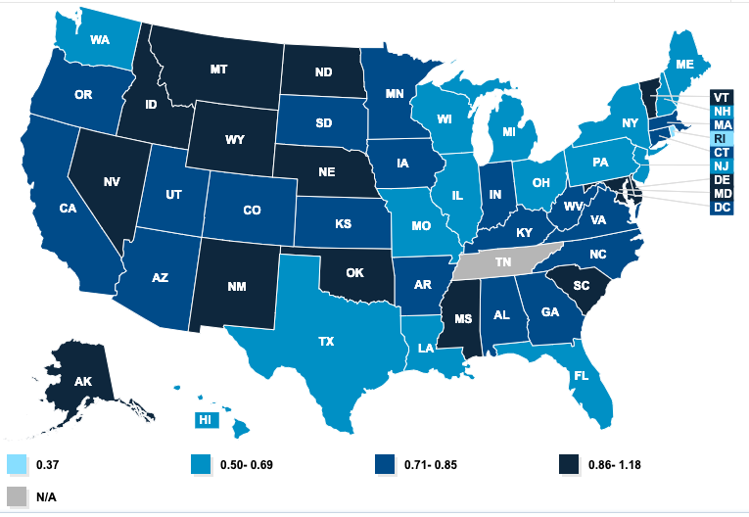
Medicaid-to-Medicare Fee Index (2019)
Source: Kaiser Family Foundation. Use this link for interactive map to view your State
Pediatrics 2025: The AMSPDC Workforce Initiative
www.amspdc.org/workforce
@AMSPDC
#Peds2025Workforce

Slide 21
Enhance education, training, recruitment, and retention
Pediatric departments, medical schools and health systems should develop, implement, and publicly report on plans and outcomes to attract, support, and retain a diverse pediatric subspecialty workforce
The responsible individuals and entities above should publicly report annual metrics on the demographics of their pediatric subspecialty workforce
Pediatrics 2025: The AMSPDC Workforce Initiative
www.amspdc.org/workforce
@AMSPDC
#Peds2025Workforce

Slide 22
Enhance education, training, recruitment, and retention
3. Congress should reform graduate medical education (GME) formulas and programs, including Medicare GME and Children’s Hospital GME, to ensure equitable and sufficient support for pediatric GME. (See next slide)
4. Funding should be distributed to address priority pediatric workforce needs, such as increased inclusion of clinicians from underrepresented in medicine backgrounds, high-priority subspecialties, geographic shortages, and enhanced training for new models of care
Pediatrics 2025: The AMSPDC Workforce Initiative
www.amspdc.org/workforce
@AMSPDC
#Peds2025Workforce

Slide 23
Children’s Hospitals GME
CHGME supports the training of half the nations pediatricians and most subspecialists
CHGME funding per trainee is less than half of Medicare GME.
Medicare GME funds grow 4% annually
Long-term goal is parity with Medicare GME
Actual and Projected CHGME Payments Compared to Medicare GME Payments per Resident
Will decline to 46% of Medicare GME by 2026 if action is not taken
Current funding is $385 million
Full funding will require $735 million
Pediatrics 2025: The AMSPDC Workforce Initiative
www.amspdc.org/workforce
@AMSPDC
#Peds2025Workforce
Notes:
CHGME program trains over 7,000 residents annually but represents just 2% of total federal spending on graduate medical education (GME). Medicare GME funds for similar training are expected to grow 4% this year.
Funding for training children’s physicians through CHGME is half that provided per trainee in the Medicare GME program: $79,813 per resident versus $156,128 per resident.

Slide 24
Enhance education, training, recruitment, and retention
5. AMSPDC should convene a multi-organization group to review and adjust educational and training curricula for pediatric residents and fellows.
6. The ABP, the AOBP and the ACGME should develop, implement, and evaluate distinct fellowship training pathways, including a 2-year option for those who aspire to a career with a primary focus on clinical care.
Pediatrics 2025: The AMSPDC Workforce Initiative
www.amspdc.org/workforce
@AMSPDC
#Peds2025Workforce

Slide 25
Support the pediatric physician-scientist pathway
  Increase number of career development awards.
  Fully fund the Pediatric Subspecialty Loan Repayment Program
    Congress should increase funding for the Pediatric Specialty Loan Repayment Program to $30 million as originally authorized (see next slide) and expand eligibility to include pediatric physician-scientists
    HRSA should focus on loan repayment for high-priority pediatric medical subspecialties as well as subspecialists from underrepresented in medicine and/or economically disadvantaged backgrounds
Pediatrics 2025: The AMSPDC Workforce Initiative
www.amspdc.org/workforce
@AMSPDC
#Peds2025Workforce

Slide 26

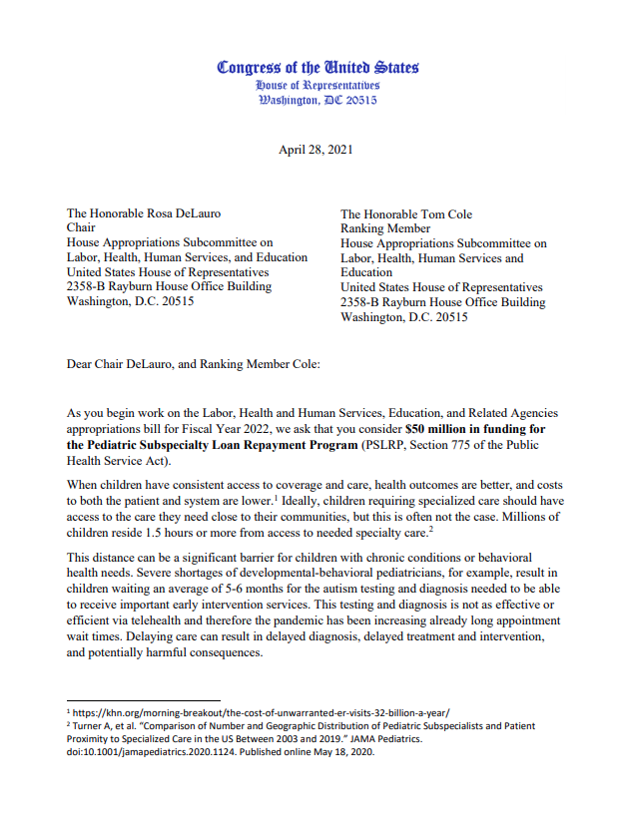
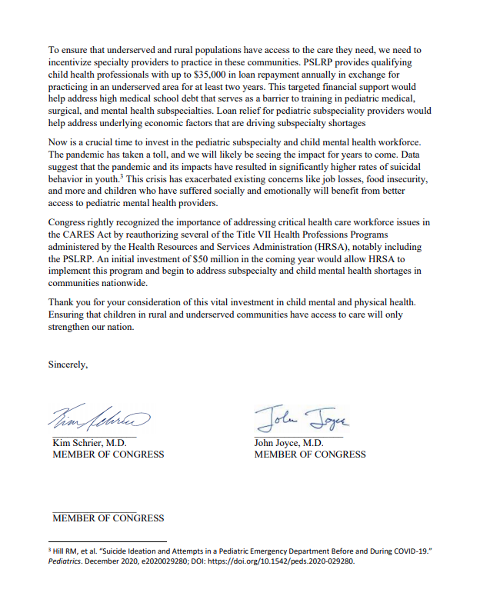
Pediatric Subspecialty Loan Repayment Program
Authorized for $30 million for pediatric subspecialists with an additional $20 million for pediatric and adolescent behavioral health providers
In 2022, Congress appropriated $5 million for this program, which included behavioral health care. In 2023, a total of $15 million was appropriated
Provides up to $35K annually for up to 3 years to pediatric subspecialists who agree to practice in an underserved area
Pediatrics 2025: The AMSPDC Workforce Initiative
www.amspdc.org/workforce
@AMSPDC
#Peds2025Workforce

Slide 27
Support the pediatric physician-scientist pathway
3. The NIH and NICHD with input from the NIH’s Scientific Workforce Diversity Office should create and maintain a publicly available central repository for qualitative and quantitative data on pediatric physician–scientists’ funding and success throughout their careers
4. Quantitative data should include:
  Funding rates of career development and subsequent awards
  Tracking of research careers by demographic factors, such as sex/gender, race, ethnicity, disability status, geography, type of science across the research continuum
  Data on successful researchers and those who leave the research track
Pediatrics 2025: The AMSPDC Workforce Initiative
www.amspdc.org/workforce
@AMSPDC
#Peds2025Workforce

Slide 28
Slides reviewed and prepared by
Laura Degnon, CAE laura@amspdc.org
Joe St Geme, MD stgemeiiij@chop.edu
Bob Vinci, MD bvinci@bu.edu
For comments, questions or suggestions feel free to email.
Pediatrics 2025: The AMSPDC Workforce Initiative
www.amspdc.org/workforce
@AMSPDC
#Peds2025Workforce

