Slide 1
Policy and Advocacy

Slide 2
Shetal Shah, MD, chair
(10/1/2020 – 12/31/2022)
Academic Pediatric Association
Mona Patel, MD
Jean Raphael, MD, MPH
American Pediatric Society
Jonathan Davis, MD
DeWayne Pursley, MD, MPH
Association of Medical School Pediatric Department Chairs
Tina Cheng, MD, MPH
Sherin Devaskar, MD
Society for Pediatric Research
Joyce Javier, MD
Lois Lee, MD, MPH
Staffed by American Academy of Pediatrics

Slide 3
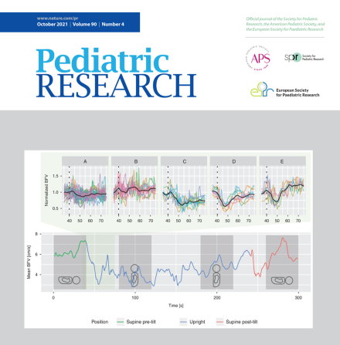
Priorities
Improving Health Care Access and Coverage
Expanding Child Health Research
Advancing Health Equity by Focusing on the Social Determ of Health
Strengthening the Next Generation of Diverse Researchers
Monthly PPC call
Liaison, AAP Committee on Federal Government Affairs
Sponsor sessions at PAS and beyond
Author commentaries in Pediatric Research
Address policy issues with legislators and agencies through letters, visits, legislation
Increase advocacy training and web and social media presence

Slide 4
Sponsored Events at PAS 2022
Expanding the Social Safety Net for Children—Recent Successes & The Work Ahead: A PPC State of the Art Plenary
Sunday, Apr. 24, 2022 | 10:00 AM – 11:30 AM MDT
Pediatric Policy Council Legislative Breakfast: Public Policy Challenges and Opportunities for LGBTQ Youth
Monday, Apr. 25 | 7:00 AM - 8:00 AM MDT
The Role of Tax Credits in Achieving Child Health Equity
Saturday, April 23, 2022 | 8:00 AM - 9:30 AM MDT
Drug Pricing and Access to Medications: Impact on Child Health
Saturday, April 23, 2022 | 10:00 AM – 11:30 AM MDT
The State of Pediatric Research - Are We Still Meeting Today's Academic Challenges?
Saturday, April 23, 2022 | 1:00 PM - 2:30 PM US MDT
Getting Promoted As An Academic Advocate: What to do, what to avoid.
Sunday, April 24, 2022 | 1:00 PM - 2:30 PM MDT

Slide 5
Sponsored Events at PAS 2022
APS SPR Joint Presidential Plenary
Reducing susceptibility to misinformation: COVID, Climate, and Conspiracies
April 22, 2022 2:30-4:00 pm MT
Reducing susceptibility to misinformation: COVID, Climate, and Conspiracies
Speaker: Kathleen Hall Jamieson
State Politics & Public Health: A cautionary tale
Speaker Michelle Fiscus
It’s Not Politics. It’s Child Health.
Speaker Judy Schaechter

